Slide 1
Parallel Programming With Spark
Matei Zaharia
UC Berkeley

Slide 2
What is Spark?
Fast, expressive cluster computing system compatible with Apache Hadoop
Works with any Hadoop-supported storage system (HDFS, S3, Avro, …)
Improves efficiency through:
In-memory computing primitives
General computation graphs
Improves usability through:
Rich APIs in Java, Scala, Python
Interactive shell
Up to 100× faster
Often 2-10× less code
Notes:
Put high-level distributed collection stuff here?

Slide 3
How to Run It
Local multicore: just a library in your program
EC2: scripts for launching a Spark cluster
Private cluster: Mesos, YARN, Standalone Mode

Slide 4
Languages
APIs in Java, Scala and Python
Interactive shells in Scala and Python

Slide 5
Outline
Introduction to Spark
Tour of Spark operations
Job execution
Standalone programs
Deployment options
Notes:
By the end of this, here’s what you’ll be able to do
Feel free to ask questions in the middle -> on Piazza?

Slide 6
Key Idea
Work with distributed collections as you would with local ones
Concept: resilient distributed datasets (RDDs)
Immutable collections of objects spread across a cluster
Built through parallel transformations (map, filter, etc)
Automatically rebuilt on failure
Controllable persistence (e.g. caching in RAM)

Slide 7
Operations
Transformations (e.g. map, filter, groupBy, join)
Lazy operations to build RDDs from other RDDs
Actions (e.g. count, collect, save)
Return a result or write it to storage
Notes:
You write a single program 🡪 similar to DryadLINQ
Distributed data sets with parallel operations on them are pretty standard; the new thing is that they can be reused across ops
Variables in the driver program can be used in parallel ops; accumulators useful for sending information back, cached vars are an optimization
Mention cached vars useful for some workloads that won’t be shown here
Mention it’s all designed to be easy to distribute in a fault-tolerant fashion

Slide 8

Example: Mining Console Logs
Load error messages from a log into memory, then interactively search for patterns
Base RDD
Cache 1
Transformed RDD
Worker
lines = spark.textFile(“hdfs://...”)
errors = lines.filter(lambda s: s.startswith(“ERROR”))
messages = errors.map(lambda s: s.split(‘\t’)[2])
messages.cache()
tasks
results
Block 1
Driver
Action
messages.filter(lambda s: “foo” in s).count()
Cache 2
Worker
messages.filter(lambda s: “bar” in s).count()
. . .
Cache 3
Worker
Block 2
Result: full-text search of Wikipedia in <1 sec (vs 20 sec for on-disk data)
Result: scaled to 1 TB data in 5-7 sec (vs 170 sec for on-disk data)
Block 3
Notes:
Key idea: add “variables” to the “functions” in functional programming

Slide 9
RDD Fault Tolerance
RDDs track the transformations used to build them (their lineage) to recompute lost data
E.g:
messages = textFile(...).filter(lambda s: s.contains(“ERROR”))
.map(lambda s: s.split(‘\t’)[2])
HadoopRDD
path = hdfs://…
FilteredRDD
func = contains(...)
MappedRDD
func = split(…)
Notes:
Show recomputing

Slide 10
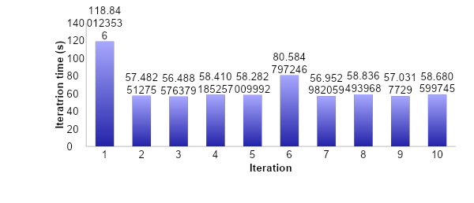
Fault Recovery Test
Failure happens
Notes:
These are for K-means

Slide 11
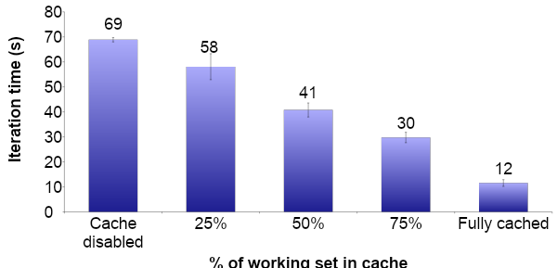
Behavior with Less RAM

Slide 12
Spark in Java and Scala
Java API:
JavaRDD<String> lines = spark.textFile(…); errors = lines.filter( new Function<String, Boolean>() { public Boolean call(String s) { return s.contains(“ERROR”); } }); errors.count()
Scala API:
val lines = spark.textFile(…) errors = lines.filter(s => s.contains(“ERROR”)) // can also write filter(_.contains(“ERROR”)) errors.count

Slide 13
Which Language Should I Use?
Standalone programs can be written in any, but console is only Python & Scala
Python developers: can stay with Python for both
Java developers: consider using Scala for console (to learn the API)
Performance: Java / Scala will be faster (statically typed), but Python can do well for numerical work with NumPy

Slide 14
Scala Cheat Sheet
Variables:
var x: Int = 7 var x = 7 // type inferred
val y = “hi” // read-only
Collections and closures:
val nums = Array(1, 2, 3)
nums.map((x: Int) => x + 2) // => Array(3, 4, 5)
nums.map(x => x + 2) // => same nums.map(_ + 2) // => same
nums.reduce((x, y) => x + y) // => 6 nums.reduce(_ + _) // => 6
Functions:
def square(x: Int): Int = x*x
def square(x: Int): Int = { x*x // last line returned }
Java interop:
import java.net.URL
new URL(“http://cnn.com”).openStream()
More details:
scala-lang.org

Slide 15
Outline
Introduction to Spark
Tour of Spark operations
Job execution
Standalone programs
Deployment options
Notes:
By the end of this, here’s what you’ll be able to do
Feel free to ask questions in the middle -> on Piazza?

Slide 16
Learning Spark
Easiest way: Spark interpreter (spark-shell or pyspark)
Special Scala and Python consoles for cluster use
Runs in local mode on 1 thread by default, but can control with MASTER environment var:
MASTER=local ./spark-shell # local, 1 thread MASTER=local[2] ./spark-shell # local, 2 threads MASTER=spark://host:port ./spark-shell # Spark standalone cluster

Slide 17
First Stop: SparkContext
Main entry point to Spark functionality
Created for you in Spark shells as variable sc
In standalone programs, you’d make your own (see later for details)

Slide 18
Creating RDDs
# Turn a local collection into an RDD
sc.parallelize([1, 2, 3])
# Load text file from local FS, HDFS, or S3
sc.textFile(“file.txt”)
sc.textFile(“directory/*.txt”)
sc.textFile(“hdfs://namenode:9000/path/file”)
# Use any existing Hadoop InputFormat
sc.hadoopFile(keyClass, valClass, inputFmt, conf)

Slide 19
Basic Transformations
nums = sc.parallelize([1, 2, 3])
# Pass each element through a function
squares = nums.map(lambda x: x*x) # => {1, 4, 9}
# Keep elements passing a predicate
even = squares.filter(lambda x: x % 2 == 0) # => {4}
# Map each element to zero or more others
nums.flatMap(lambda x: range(0, x)) # => {0, 0, 1, 0, 1, 2}
Range object (sequence of numbers 0, 1, …, x-1)
Notes:
All lazy

Slide 20
Basic Actions
nums = sc.parallelize([1, 2, 3])
# Retrieve RDD contents as a local collection nums.collect() # => [1, 2, 3]
# Return first K elements nums.take(2) # => [1, 2]
# Count number of elements nums.count() # => 3
# Merge elements with an associative function nums.reduce(lambda x, y: x + y) # => 6
# Write elements to a text file nums.saveAsTextFile(“hdfs://file.txt”)
Notes:
Launch computations

Slide 21
Working with Key-Value Pairs
Spark’s “distributed reduce” transformations act on RDDs of key-value pairs
Python: pair = (a, b)
pair[0] # => a
pair[1] # => b
Scala: val pair = (a, b)
pair._1 // => a
pair._2 // => b
Java: Tuple2 pair = new Tuple2(a, b); // class scala.Tuple2
pair._1 // => a
pair._2 // => b

Slide 22
Some Key-Value Operations
pets = sc.parallelize([(“cat”, 1), (“dog”, 1), (“cat”, 2)])
pets.reduceByKey(lambda x, y: x + y) # => {(cat, 3), (dog, 1)}
pets.groupByKey() # => {(cat, Seq(1, 2)), (dog, Seq(1)}
pets.sortByKey() # => {(cat, 1), (cat, 2), (dog, 1)}
reduceByKey also automatically implements combiners on the map side

Slide 23
Example: Word Count
lines = sc.textFile(“hamlet.txt”)
counts = lines.flatMap(lambda line: line.split(“ ”)) \ .map(lambda word: (word, 1)) \ .reduceByKey(lambda x, y: x + y)
“to” “be” “or”
(to, 1) (be, 1) (or, 1)
(be, 2) (not, 1)
“to be or”
“not” “to” “be”
(not, 1) (to, 1) (be, 1)
(or, 1)
(to, 2)
“not to be”

Slide 24
Multiple Datasets
visits = sc.parallelize([(“index.html”, “1.2.3.4”), (“about.html”, “3.4.5.6”), (“index.html”, “1.3.3.1”)])
pageNames = sc.parallelize([(“index.html”, “Home”), (“about.html”, “About”)])
visits.join(pageNames) # (“index.html”, (“1.2.3.4”, “Home”)) # (“index.html”, (“1.3.3.1”, “Home”)) # (“about.html”, (“3.4.5.6”, “About”))
visits.cogroup(pageNames) # (“index.html”, (Seq(“1.2.3.4”, “1.3.3.1”), Seq(“Home”))) # (“about.html”, (Seq(“3.4.5.6”), Seq(“About”)))

Slide 25
Controlling the Level of Parallelism
All the pair RDD operations take an optional second parameter for number of tasks
words.reduceByKey(lambda x, y: x + y, 5)
words.groupByKey(5)
visits.join(pageViews, 5)

Slide 26
Using Local Variables
External variables you use in a closure will automatically be shipped to the cluster:
query = raw_input(“Enter a query:”)
pages.filter(lambda x: x.startswith(query)).count()
Some caveats:
Each task gets a new copy (updates aren’t sent back)
Variable must be Serializable (Java/Scala) or Pickle-able (Python)
Don’t use fields of an outer object (ships all of it!)

Slide 27
Closure Mishap Example
class MyCoolRddApp { val param = 3.14 val log = new Log(...) ... def work(rdd: RDD[Int]) { rdd.map(x => x + param) .reduce(...) } }
How to get around it:
class MyCoolRddApp { ... def work(rdd: RDD[Int]) { val param_ = param rdd.map(x => x + param_) .reduce(...) } }
NotSerializableException: MyCoolRddApp (or Log)
References only local variable instead of this.param

Slide 28
More Details
Spark supports lots of other operations!
Full programming guide: spark-project.org/documentation

Slide 29
Outline
Introduction to Spark
Tour of Spark operations
Job execution
Standalone programs
Deployment options
Notes:
By the end of this, here’s what you’ll be able to do
Feel free to ask questions in the middle -> on Piazza?

Slide 30
Software Components
Spark runs as a library in your program (one instance per app)
Runs tasks locally or on a cluster
Standalone deploy cluster, Mesos or YARN
Accesses storage via Hadoop InputFormat API
Can use HBase, HDFS, S3, …
Your application
SparkContext
Cluster manager
Local threads
Worker
Worker
Spark executor
Spark executor
HDFS or other storage

Slide 31
Task Scheduler
Supports general task graphs
Pipelines functions where possible
Cache-aware data reuse & locality
Partitioning-aware to avoid shuffles
A:
B:
F:
Stage 1
groupBy
C:
D:
E:
join
Stage 2
map
filter
Stage 3
= RDD
= cached partition
Notes:
NOT a modified version of Hadoop

Slide 32
Hadoop Compatibility
Spark can read/write to any storage system / format that has a plugin for Hadoop!
Examples: HDFS, S3, HBase, Cassandra, Avro, SequenceFile
Reuses Hadoop’s InputFormat and OutputFormat APIs
APIs like SparkContext.textFile support filesystems, while SparkContext.hadoopRDD allows passing any Hadoop JobConf to configure an input source

Slide 33
Outline
Introduction to Spark
Tour of Spark operations
Job execution
Standalone programs
Deployment options
Notes:
By the end of this, here’s what you’ll be able to do
Feel free to ask questions in the middle -> on Piazza?

Slide 34
Build Spark
Requires Java 6+, Scala 2.9.2
git clone git://github.com/mesos/spark cd spark sbt/sbt package
# Optional: publish to local Maven cache sbt/sbt publish-local

Slide 35
Add Spark to Your Project
Scala and Java: add a Maven dependency on
groupId: org.spark-project artifactId: spark-core_2.9.1 version: 0.7.0-SNAPSHOT
Python: run program with our pyspark script

Slide 36
Create a SparkContext
import spark.SparkContext
import spark.SparkContext._
val sc = new SparkContext(“masterUrl”, “name”, “sparkHome”, Seq(“app.jar”))
Scala
Cluster URL, or local / local[N]
App name
Spark install path on cluster
List of JARs with app code (to ship)
import spark.api.java.JavaSparkContext;
JavaSparkContext sc = new JavaSparkContext(
“masterUrl”, “name”, “sparkHome”, new String[] {“app.jar”}));
Java
from pyspark import SparkContext
sc = SparkContext(“masterUrl”, “name”, “sparkHome”, [“library.py”]))
Python
Notes:
Mention assembly JAR in Maven etc
Use the shell with your own JAR`

Slide 37
Complete App: Scala
import spark.SparkContext
import spark.SparkContext._
object WordCount { def main(args: Array[String]) {
val sc = new SparkContext(“local”, “WordCount”, args(0), Seq(args(1))) val lines = sc.textFile(args(2)) lines.flatMap(_.split(“ ”)) .map(word => (word, 1)) .reduceByKey(_ + _) .saveAsTextFile(args(3)) } }

Slide 38
Complete App: Python
import sys
from pyspark import SparkContext
if __name__ == "__main__":
sc = SparkContext( “local”, “WordCount”, sys.argv[0], None) lines = sc.textFile(sys.argv[1])
lines.flatMap(lambda s: s.split(“ ”)) \ .map(lambda word: (word, 1)) \ .reduceByKey(lambda x, y: x + y) \ .saveAsTextFile(sys.argv[2])

Slide 39
Example: PageRank

Slide 40
Why PageRank?
Good example of a more complex algorithm
Multiple stages of map & reduce
Benefits from Spark’s in-memory caching
Multiple iterations over the same data

Slide 41
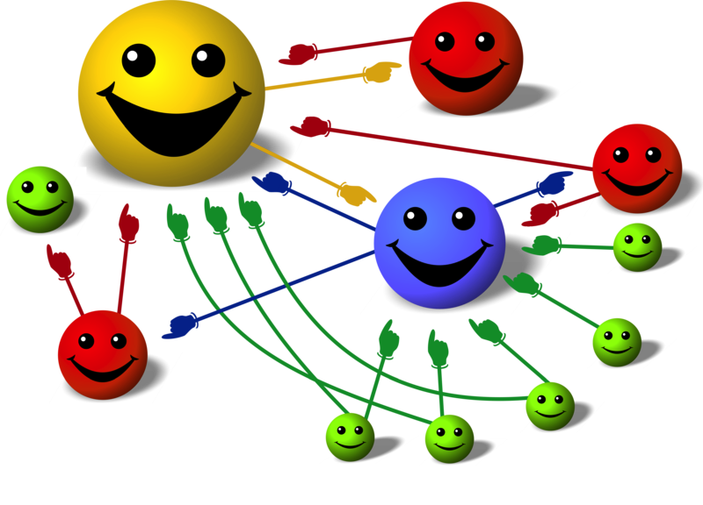
Basic Idea
Give pages ranks (scores) based on links to them
Links from many pages 🡺 high rank
Link from a high-rank page 🡺 high rank
Image: en.wikipedia.org/wiki/File:PageRank-hi-res-2.png

Slide 42
Algorithm
Start each page at a rank of 1
On each iteration, have page p contribute rank_{p} / |neighbors_{p}| to its neighbors
Set each page’s rank to 0.15 + 0.85 × contribs
1.0
1.0
1.0
1.0

Slide 43
Algorithm
Start each page at a rank of 1
On each iteration, have page p contribute rank_{p} / |neighbors_{p}| to its neighbors
Set each page’s rank to 0.15 + 0.85 × contribs
1.0
1
0.5
1
1.0
0.5
1.0
0.5
0.5
1.0

Slide 44
Algorithm
Start each page at a rank of 1
On each iteration, have page p contribute rank_{p} / |neighbors_{p}| to its neighbors
Set each page’s rank to 0.15 + 0.85 × contribs
1.85
0.58
1.0
0.58

Slide 45
Algorithm
Start each page at a rank of 1
On each iteration, have page p contribute rank_{p} / |neighbors_{p}| to its neighbors
Set each page’s rank to 0.15 + 0.85 × contribs
1.85
0.58
0.5
1.85
0.58
0.29
1.0
0.5
0.29
0.58

Slide 46
Algorithm
Start each page at a rank of 1
On each iteration, have page p contribute rank_{p} / |neighbors_{p}| to its neighbors
Set each page’s rank to 0.15 + 0.85 × contribs
1.31
0.39
. . .
1.72
0.58

Slide 47
Algorithm
Start each page at a rank of 1
On each iteration, have page p contribute rank_{p} / |neighbors_{p}| to its neighbors
Set each page’s rank to 0.15 + 0.85 × contribs
Final state:
1.44
0.46
1.37
0.73

Slide 48
Scala Implementation
val links = // RDD of (url, neighbors) pairs
var ranks = // RDD of (url, rank) pairs
for (i <- 1 to ITERATIONS) {
val contribs = links.join(ranks).flatMap {
case (url, (links, rank)) =>
links.map(dest => (dest, rank/links.size))
} ranks = contribs.reduceByKey(_ + _) .mapValues(0.15 + 0.85 * _)
} ranks.saveAsTextFile(...)

Slide 49
Python Implementation
links = # RDD of (url, neighbors) pairs
ranks = # RDD of (url, rank) pairs
for i in range(NUM_ITERATIONS):
def compute_contribs(pair): [url, [links, rank]] = pair # split key-value pair
return [(dest, rank/len(links)) for dest in links]
contribs = links.join(ranks).flatMap(compute_contribs)
ranks = contribs.reduceByKey(lambda x, y: x + y) \ .mapValues(lambda x: 0.15 + 0.85 * x) ranks.saveAsTextFile(...)

Slide 50
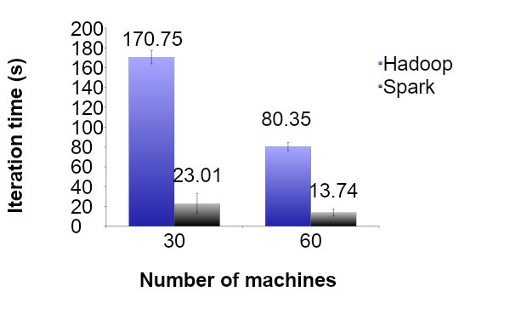
PageRank Performance
Notes:
54 GB Wikipedia dataset

Slide 51


Other Iterative Algorithms
Time per Iteration (s)
Notes:
100 GB datasets

Slide 52
Outline
Introduction to Spark
Tour of Spark operations
Job execution
Standalone programs
Deployment options
Notes:
By the end of this, here’s what you’ll be able to do
Feel free to ask questions in the middle -> on Piazza?

Slide 53
Local Mode
Just pass local or local[k] as master URL
Still serializes tasks to catch marshaling errors
Debug using local debuggers
For Java and Scala, just run your main program in a debugger
For Python, use an attachable debugger (e.g. PyDev, winpdb)
Great for unit testing

Slide 54
Private Cluster
Can run with one of:
Standalone deploy mode (similar to Hadoop cluster scripts)
Apache Mesos: spark-project.org/docs/latest/running-on-mesos.html
Hadoop YARN: spark-project.org/docs/0.6.0/running-on-yarn.html
Basically requires configuring a list of workers, running launch scripts, and passing a special cluster URL to SparkContext

Slide 55
Amazon EC2
Easiest way to launch a Spark cluster
git clone git://github.com/mesos/spark.git
cd spark/ec2
./spark-ec2 -k keypair –i id_rsa.pem –s slaves \ [launch|stop|start|destroy] clusterName
Details: spark-project.org/docs/latest/ec2-scripts.html
New: run Spark on Elastic MapReduce – tinyurl.com/spark-emr

Slide 56
Viewing Logs
Click through the web UI at master:8080
Or, look at stdout and stdout files in the Spark or Mesos “work” directory for your app:
work/<ApplicationID>/<ExecutorID>/stdout
Application ID (Framework ID in Mesos) is printed when Spark connects

Slide 57
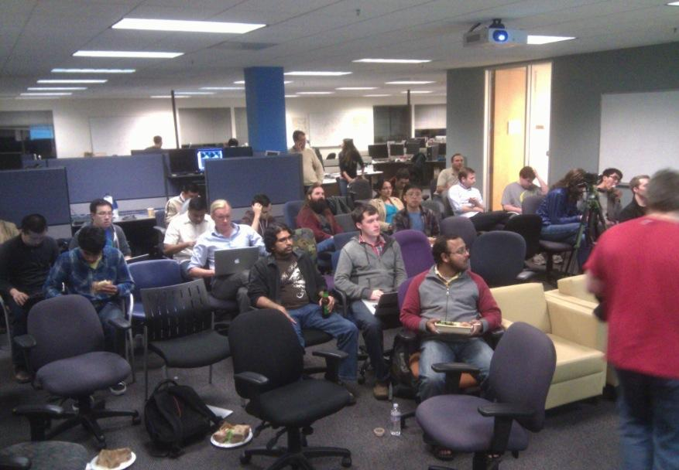
Community
Join the Spark Users mailing list:
groups.google.com/group/spark-users
Come to the Bay Area meetup:
www.meetup.com/spark-users
Notes:
Ankur’s debugger

Slide 58














Conclusion
Spark offers a rich API to make data analytics fast: both fast to write and fast to run
Achieves 100x speedups in real applications
Growing community with 14 companies contributing
Details, tutorials, videos: www.spark-project.org

